Slide 1
Memory & Assembly in Hack
Annotation Strategies Discussion, Hack Assembly Memory Representation, Multiplication Implementation Exercise, Project 5 Overview

Slide 2
Lecture Outline
Annotation Strategies Discussion
  Reflection on Annotating Final Memory Chip Reading
Hack Assembly Memory Representation
  Input / Output, Memory Mapping, External / Internal Memory
Multiplication Implementation Exercise
  Multiplying Two Numbers in Hack Assembly
Project 5 Overview
  Specification Annotation, Machine Language, & Building Computer Memory

Slide 3
Annotation Strategies Discussion
Which annotation strategies did you try for the Final Memory Chip reading?
Did using annotation strategies help you comprehend the text more than usual? Why or why not?
Any surprises or interesting observations from annotating?
What might you change about your existing annotation strategies? What other annotation strategies might you try?

Slide 4
Lecture Outline
Annotation Strategies Discussion
  Reflection on Annotating Final Memory Chip Reading
Hack Assembly Memory Representation
  Input / Output, Memory Mapping, External / Internal Memory
Multiplication Implementation Exercise
  Multiplying Two Numbers in Hack Assembly
Project 5 Overview
  Specification Annotation, Machine Language, & Building Computer Memory

Slide 5
Which of the following statements from the Final Memory Chip reading is FALSE?
Hexadecimal is useful because it’s easier for humans to read while still being interpretable by a computer
0x390B in binary is 0b0011_1001_0000_1011
390 in hexadecimal is 0x186
In Hack, the two devices the user can interact with are the screen and the keyboard
We’re lost…

Slide 6
Lecture 3 Review: What is Binary?
A base n number system is a system of number representation with n symbols
Decimal system is a base 10 number system
  Base 10 symbols: 0, 1, 2, 3, 4, 5, 6, 7, 8, 9
  Increase a number by moving to the next greatest symbol
  Add another digit when we run out of symbols
Binary is a base 2 number system
  Often prefixed with 0b (e.g., 0b1101, 0b10)
  Base 2 symbols: 0, 1

Slide 7
Hexadecimal
Base 16 number system
  Symbols: 0, 1, 2, 3, 4, 5, 6, 7, 8, 9, A, B, C, D, E, F
Commonly used for referring to memory addresses
  Simple to convert between binary and hexadecimal
  Hexadecimal uses fewer digits to represent a value than binary
Uses the prefix 0x to indicate a number is written in hexadecimal
  32 is decimal, 0x32 is hexadecimal

Slide 8
Number Representation Comparison
Decimal | Hexadecimal | Binary
0 | 0x0 | 0b0000
1 | 0x1 | 0b0001
2 | 0x2 | 0b0010
3 | 0x3 | 0b0011
4 | 0x4 | 0b0100
5 | 0x5 | 0b0101
6 | 0x6 | 0b0110
7 | 0x7 | 0b0111
8 | 0x8 | 0b1000
9 | 0x9 | 0b1001
10 | 0xA | 0b1010
11 | 0xB | 0b1011
12 | 0xC | 0b1100
13 | 0xD | 0b1101
14 | 0xE | 0b1110
15 | 0xF | 0b1111

Slide 9
Binary and Hexadecimal Conversion
One-to-one correspondence between binary and hexadecimal
To convert from binary to hexadecimal, swap out binary bits for the corresponding hexadecimal digit (or vice versa)
Example: 0x3A is 0b0011_1010
  0x3 == 0b0011
  0xA == 0b1010

Slide 10
Hack Assembly: Input / Output
Two memory maps are created for you by underlying hardware
  SCREEN is a huge map where each pixel is one bit
  KEYBOARD is a single 16-bit word map with code of current key
Example:
@KBD
D=M
@SCREEN
M=D
D contains code of current key (e.g., 67 for “C”)
First 16 bits of screen (top left) show binary for 67

Slide 11

Hack: Input / Output (I/O)
I/O is memory mapped
  Corresponds to some region of RAM
  Low-level drivers are constantly refreshing
COMPUTER
MEMORY
CPU
ROM
1110001011111100
REGISTERS
RAM
1100101010010101
0110010101100000
1101010010111001
0010110101001000
1010001001001000
1101101111101001
A/M
D
SCREEN
CONTROL
KEYBOARD
PC

Slide 12
Hack: Memory Mapped Output
Each bit of the screen memory map corresponds to one pixel (1 = black, 0 = white)
The start of the memory map is accessible via the SCREEN symbol in Hack.asm
RAM
1100101010010101
0110010101100000
1101010010111001
0010110101001000
1010001001001000
1101101111101001
SCREEN

Slide 13
Hack: Memory Mapped Output
A single 16-bit word in memory is constantly refreshed with the scan code of the keyboard button being pressed
This spot in memory accessible via the KBD constant in Hack.asm
RAM
1100101010010101
0110010101100000
1101010010111001
0010110101001000
1010001001001000
1101101111101001
KEYBOARD
‘k’ is pressed
The code 65 appears in RAM

Slide 14
Hack: External Memory Abstraction
Programmer sees one RAM32K memory region
  Only 16K + 8K + 1 registers are being used
Split into three parts: SCREEN, KEYBOARD, and the rest
  Screen: 8K registers
  Keyboard: 1 register
  The rest: 16K registers (used for data and instructions)
Programmer can use the same interface to interact with the SCREEN, KEYBOARD, or normal RAM
  Just specify address, value, and other inputs
  Address determines what part we are interacting with

Slide 15
Hack: Internal Memory Implementation
In reality, separate memory chips for memory devices is unnecessary
  “Drivers” are code relaying changes in memory values to the device
In Hack, it’s not as simple as one RAM32K chip
  Use internal SCREEN and KEYBOARD chips so our virtual computer can detect and show changes in the screen and keyboard
Our memory chip has three subchips: SCREEN, KEYBOARD, and RAM16K
  Process the address given by the programmer and relay the request to the appropriate subchip

Slide 16
Hack: Memory Abstraction User View
RAM
1100101010010101
0110010101100000
1101010010111001
0010110101001000
1010001001001000
1101101111101001
0010110101001000
1010001001001000
0010110101001000
1101101111101001
0010110101001000
1010001001001000
0010110101001000
1010001001001000
1101101111101001
0010110101001000
1010001001001000
1101101111101001
USER
Screen address
Keyboard address

Slide 17
Hack: Memory Abstraction Internal View
RAM
RAM16K
1100101010010101
0110010101100000
1101010010111001
0010110101001000
1010001001001000
1101101111101001
SCREEN
1100101010010101
0110010101100000
1101010010111001
USER
IMPLEMENTATION
KEYBOARD
1100101010010101

Slide 18
Lecture Outline
Annotation Strategies Discussion
  Reflection on Annotating Final Memory Chip Reading
Hack Assembly Memory Representation
  Input / Output, Memory Mapping, External / Internal Memory
Multiplication Implementation Exercise
  Multiplying Two Numbers in Hack Assembly
Project 5 Overview
  Specification Annotation, Machine Language, & Building Computer Memory

Slide 19
Hack: Registers
D Register: For storing Data
A Register: For storing data and Addressing memory
M “Register”: The 16-bit word in Memory currently being referenced by the address in A
RAM
1100101010010101
...
106
107
108
109
110
...
REGISTERS
M
A
108
D

Slide 20
Hack: A-Instructions
Syntax:
value can either be:
  A non-negative decimal constant
  A symbol referring to a constant
Semantics:
  Stores value in the A register
@value

Slide 21
Hack: C-Instructions
Syntax: (dest and jump optional)
  dest is a combination of destination registers:
  comp is a computation:
  jump is an unconditional or conditional jump:
Semantics:
  Computes value of comp
  Stores results in dest (if specified)
  If jump is specified and condition is true (by testing comp result), jump to instruction ROM[A]
dest = comp ; jump
M, D, MD, A, AM, AD, AMD
0, 1, -1, D, A, !D, !A, -D, -A, D+1, A+1, D-1, A-1, D+A, D-A, A-D, D&A, D|A, M, !M, -M, M+1, M-1, D+M, D-M, M-D, D&M, D|M
JGT, JEQ, JGE, JLT, JNE, JLE, JMP

Slide 22
Hack: C-Instructions Example
A Register
D Register
55
56
00
01
(EXAMPLE)
@55
D=A+1

Slide 23
Hack: C-Instructions Example
A Register
D Register
55
56
00
01
02
03
(EXAMPLE)
@55
D=A+1
@R2
M=D
RAM
0
?
A Register
D Register
1
?
2
56
2
56
...

Slide 24
Hack: C-Instructions Example
A Register
D Register
55
56
00
01
02
03
04
05
(EXAMPLE)
@55
D=A+1
@R2
M=D
@EXAMPLE
D;JGT
RAM
0
?
A Register
D Register
1
?
2
56
2
56
...
A Register
D Register
0
56
(Will jump to instruction 0, since D > 0)

Slide 25
Five-minute Break!
Feel free to stand up, stretch, use the restroom, drink some water, review your notes, or ask questions
We’ll be back at:
Research shows mid-lecture breaks reduce the decline of attention in the middle of lecture (Olmsted, 1999)
Olmsted III, John. “The Mid-Lecture Break: When Less Is More.” Journal of Chemical Education (1999). https://pubs.acs.org/doi/abs/10.1021/ed076p525.

Slide 26
Exercise: Implementing Multiplication
Write a program that multiplies R0 and R1 and stores the result in R2
  Remember we don’t have a multiply operation
  We will have to use add and loops to get the job done
Roadmap
  Start with pseudocode using if statements, loops, etc.
  Remove conditionals and loops by using jumps in pseudocode
  Convert pseudocode to assembly

Slide 27
Exercise: Implementing Multiplication
Goal: Implement R0 × R1 = R2
Pseudocode, add R0 to the result R1 times:

Slide 28
Exercise: Implementing Multiplication
Goal: Implement R0 × R1 = R2
Pseudocode, add R0 to the result R1 times:
R2 = 0
while (R1 > 0) {
R2 = R0 + R2
R1 = R1 - 1
}

Slide 29
Exercise: Implementing Multiplication
Remove loops from pseudocode
Uses labels to notate important sections of the code
Attempt 1: What happens when R1 is 0? What should happen?
START:
R2 = 0
LOOP:
R2 = R0 + R2
R1 = R1 - 1
IF R1 > 0 JMP LOOP
END:
INFINITE LOOP
R2 = 0
while (R1 > 0) {
R2 = R0 + R2
R1 = R1 - 1
}

Slide 30
Exercise: Implementing Multiplication
Remove loops from pseudocode
Uses labels to notate important sections of the code
Attempt 1: What happens when R1 is 0? What should happen?
START:
R2 = 0
LOOP:
IF R1 <= 0
JMP to END
R2 = R0 + R2
R1 = R1 - 1
JMP LOOP
END:
INFINITE LOOP
R2 = 0
while (R1 > 0) {
R2 = R0 + R2
R1 = R1 - 1
}

Slide 31
Exercise: Implementing Multiplication
Convert to Hack Assembly
START:
R2 = 0
LOOP:
IF R1 <= 0
JMP to END
R2 = R0 + R2
R1 = R1 - 1
JMP LOOP
END:
INFINITE LOOP
(START)
@R2
M = 0
(LOOP)
(END)

Slide 32
Exercise: Implementing Multiplication
Convert to Hack Assembly
START:
R2 = 0
LOOP:
IF R1 <= 0
JMP to END
R2 = R0 + R2
R1 = R1 - 1
JMP LOOP
END:
INFINITE LOOP
(START)
@R2
M = 0
(LOOP)
@R1
D = A
@END
D; JLE
(END)

Slide 33
Exercise: Implementing Multiplication
Convert to Hack Assembly
START:
R2 = 0
LOOP:
IF R1 <= 0
JMP to END
R2 = R0 + R2
R1 = R1 - 1
JMP LOOP
END:
INFINITE LOOP
(START)
@R2
M = 0
(LOOP)
@R1
D = M
@END
D; JLE
(END)

Slide 34
Exercise: Implementing Multiplication
Convert to Hack Assembly
(START)
@R2
M = 0
(LOOP)
@R1
D = M
@END
D; JLE
@R0
D = M
@R2
M = M + D
(END)
START:
R2 = 0
LOOP:
IF R1 <= 0
JMP to END
R2 = R0 + R2
R1 = R1 - 1
JMP LOOP
END:
INFINITE LOOP

Slide 35
Exercise: Implementing Multiplication
(START)
@R2
M = 0
(LOOP)
@R1
D = M
@END
D; JLE
@R0
D = M
@R2
M = M + D
@R1
M = M - 1
@LOOP
0; JMP
(END)
Convert to Hack Assembly
START:
R2 = 0
LOOP:
IF R1 <= 0
JMP to END
R2 = R0 + R2
R1 = R1 - 1
JMP LOOP
END:
INFINITE LOOP

Slide 36
Exercise: Implementing Multiplication
Convert to Hack Assembly
(START)
@R2
M = 0
(LOOP)
@R1
D = M
@END
D; JLE
@R0
D = M
@R2
M = M + D
@R1
M = M – 1
@LOOP
0; JMP
(END)
@END
0; JMP
START:
R2 = 0
LOOP:
IF R1 <= 0
JMP to END
R2 = R0 + R2
R1 = R1 - 1
JMP LOOP
END:
INFINITE LOOP

Slide 37
Lecture Outline
Annotation Strategies Discussion
  Reflection on Annotating Final Memory Chip Reading
Hack Assembly Memory Representation
  Input / Output, Memory Mapping, External / Internal Memory
Multiplication Implementation Exercise
  Multiplying Two Numbers in Hack Assembly
Project 5 Overview
  Specification Annotation, Machine Language, & Building Computer Memory

Slide 38
Project 5 Overview
Part I: Annotation
  Come prepared to your upcoming Student-TA 1:1 meeting to work on Project 5 (e.g., specification reading and identifying annotation strategies you would want to use)
Part II: Machine Language
  Implement Max.asm in Hack Assembly
Part III: Building Computer Memory
  Implement Memory.hdl in HDL
Part IV: Project 5 Reflection

Slide 39
Project 5, Part I: Annotation
Fill out the Assignment Timeline
  Divide up Project 5 into doable chunks for the days you plan to work on the assignment
  Describe each day’s task in as much detail as possible
Annotate the Project 5 Specification
  Identify five annotation strategies that you want to try
  Practice these strategies on the Project 5 specification
Complete Annotation Reflection Questions
  Reflect on the strategies you used and why or why not they were effective

Slide 40
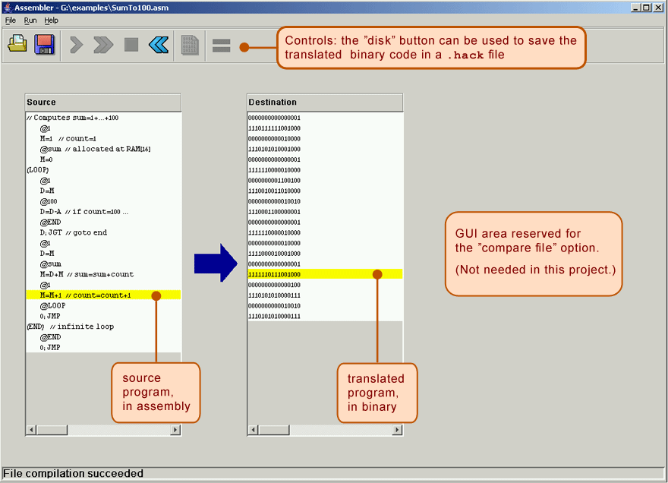
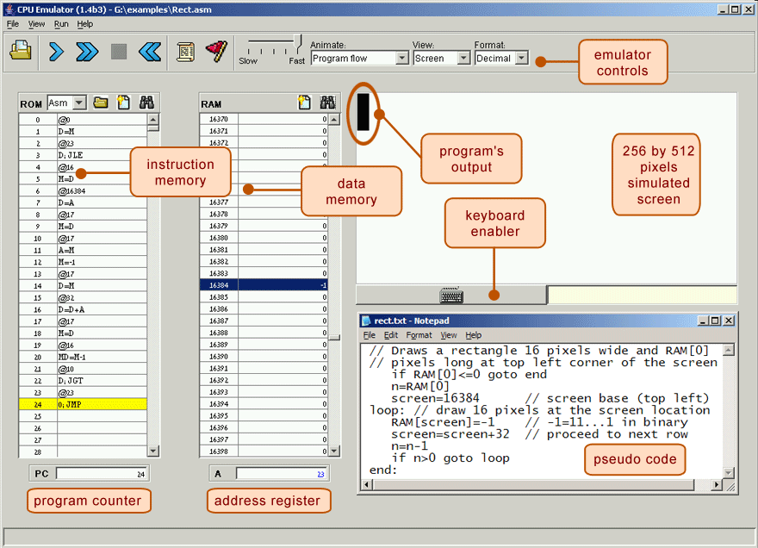
Project 5: Tools
The test scripts use the .hack files directly! Don’t let your .asm and .hack get out of sync!
Running a Test Script
(recommended flow):
Quickly Iterating or Experimenting:
Max.asm
Max.hack
Assembler
CPUEmulator
Max.asm
CPUEmulator
Can still “run” the program directly from the .asm file

Slide 41
Lecture 8 Wrap-up
Thrilled for these Week 5 topics!
  Metacognitive Subject: Exam Preparation
  Technical Subject: Building a Computer
Project Reminders
  Project 3 grades and feedback released
  Project 4 due tonight (4/21) at 11:59pm PDT
  Project 5 released, due next Thursday (4/28) at 11:59pm PDT
Midterm Exam coming up in two weeks (5/5) during lecture time

